Slide 1
Hotel Management System
CO226-DATABASE SYSTEMS
GROUP 01
E/18/022 AMARASINGHE D. I.
E/18/327 SENEVIRATHNA M. D. C. D.
E/18/349 THALISHA W. G. A. P.

Slide 2


Project description
The Hotel AppleBees currently using a file-based data management system, which is manually operated. There are some downsides can be recognized.
Data redundancy & inconsistency.
Difficult in accessing old data.
Lack of security for data in the system.
Time-consuming.
As a solution, computerized hotel management system can be implemented. The database system makes efficient data handling and retrieval data more easily and accurately. Records can be generated under several categories at any time. We can achieve several advantages in database management system.
Save time
More security and Privacy
No redundant data
Easy access/ Friendly UI

Slide 3

Users and their requirements
System Admins:
Add / Update / Delete / view Staff members
View guests
Add / Update / Delete / view suppliers
Update / View food, beverages & room details
View reports
Receptionist:
Add / Update / Delete / View guests
Make reservations
View room details
Issue Bills
Restaurant staff:
View food & beverages details
Make a food bill and add to the system
Guests:
View food & beverage details
View room details

Slide 4

Conceptual Model

Slide 5
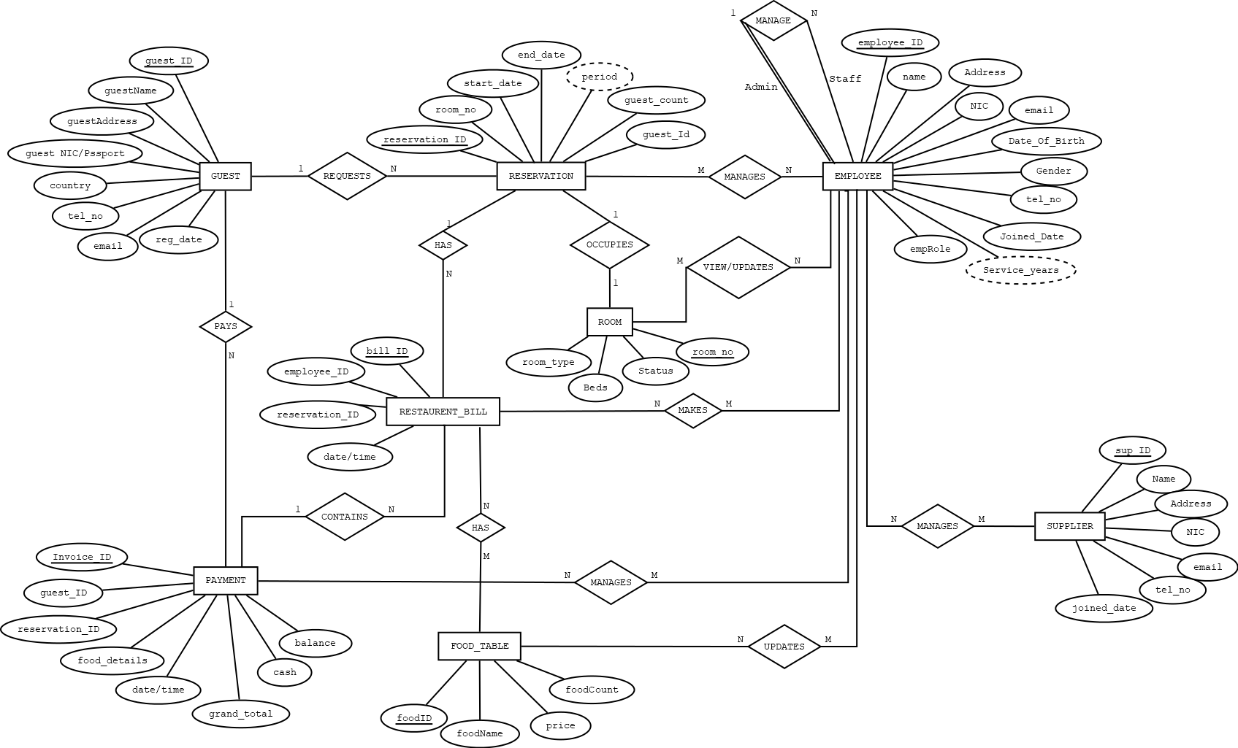

Slide 6

Logical Model

Slide 7
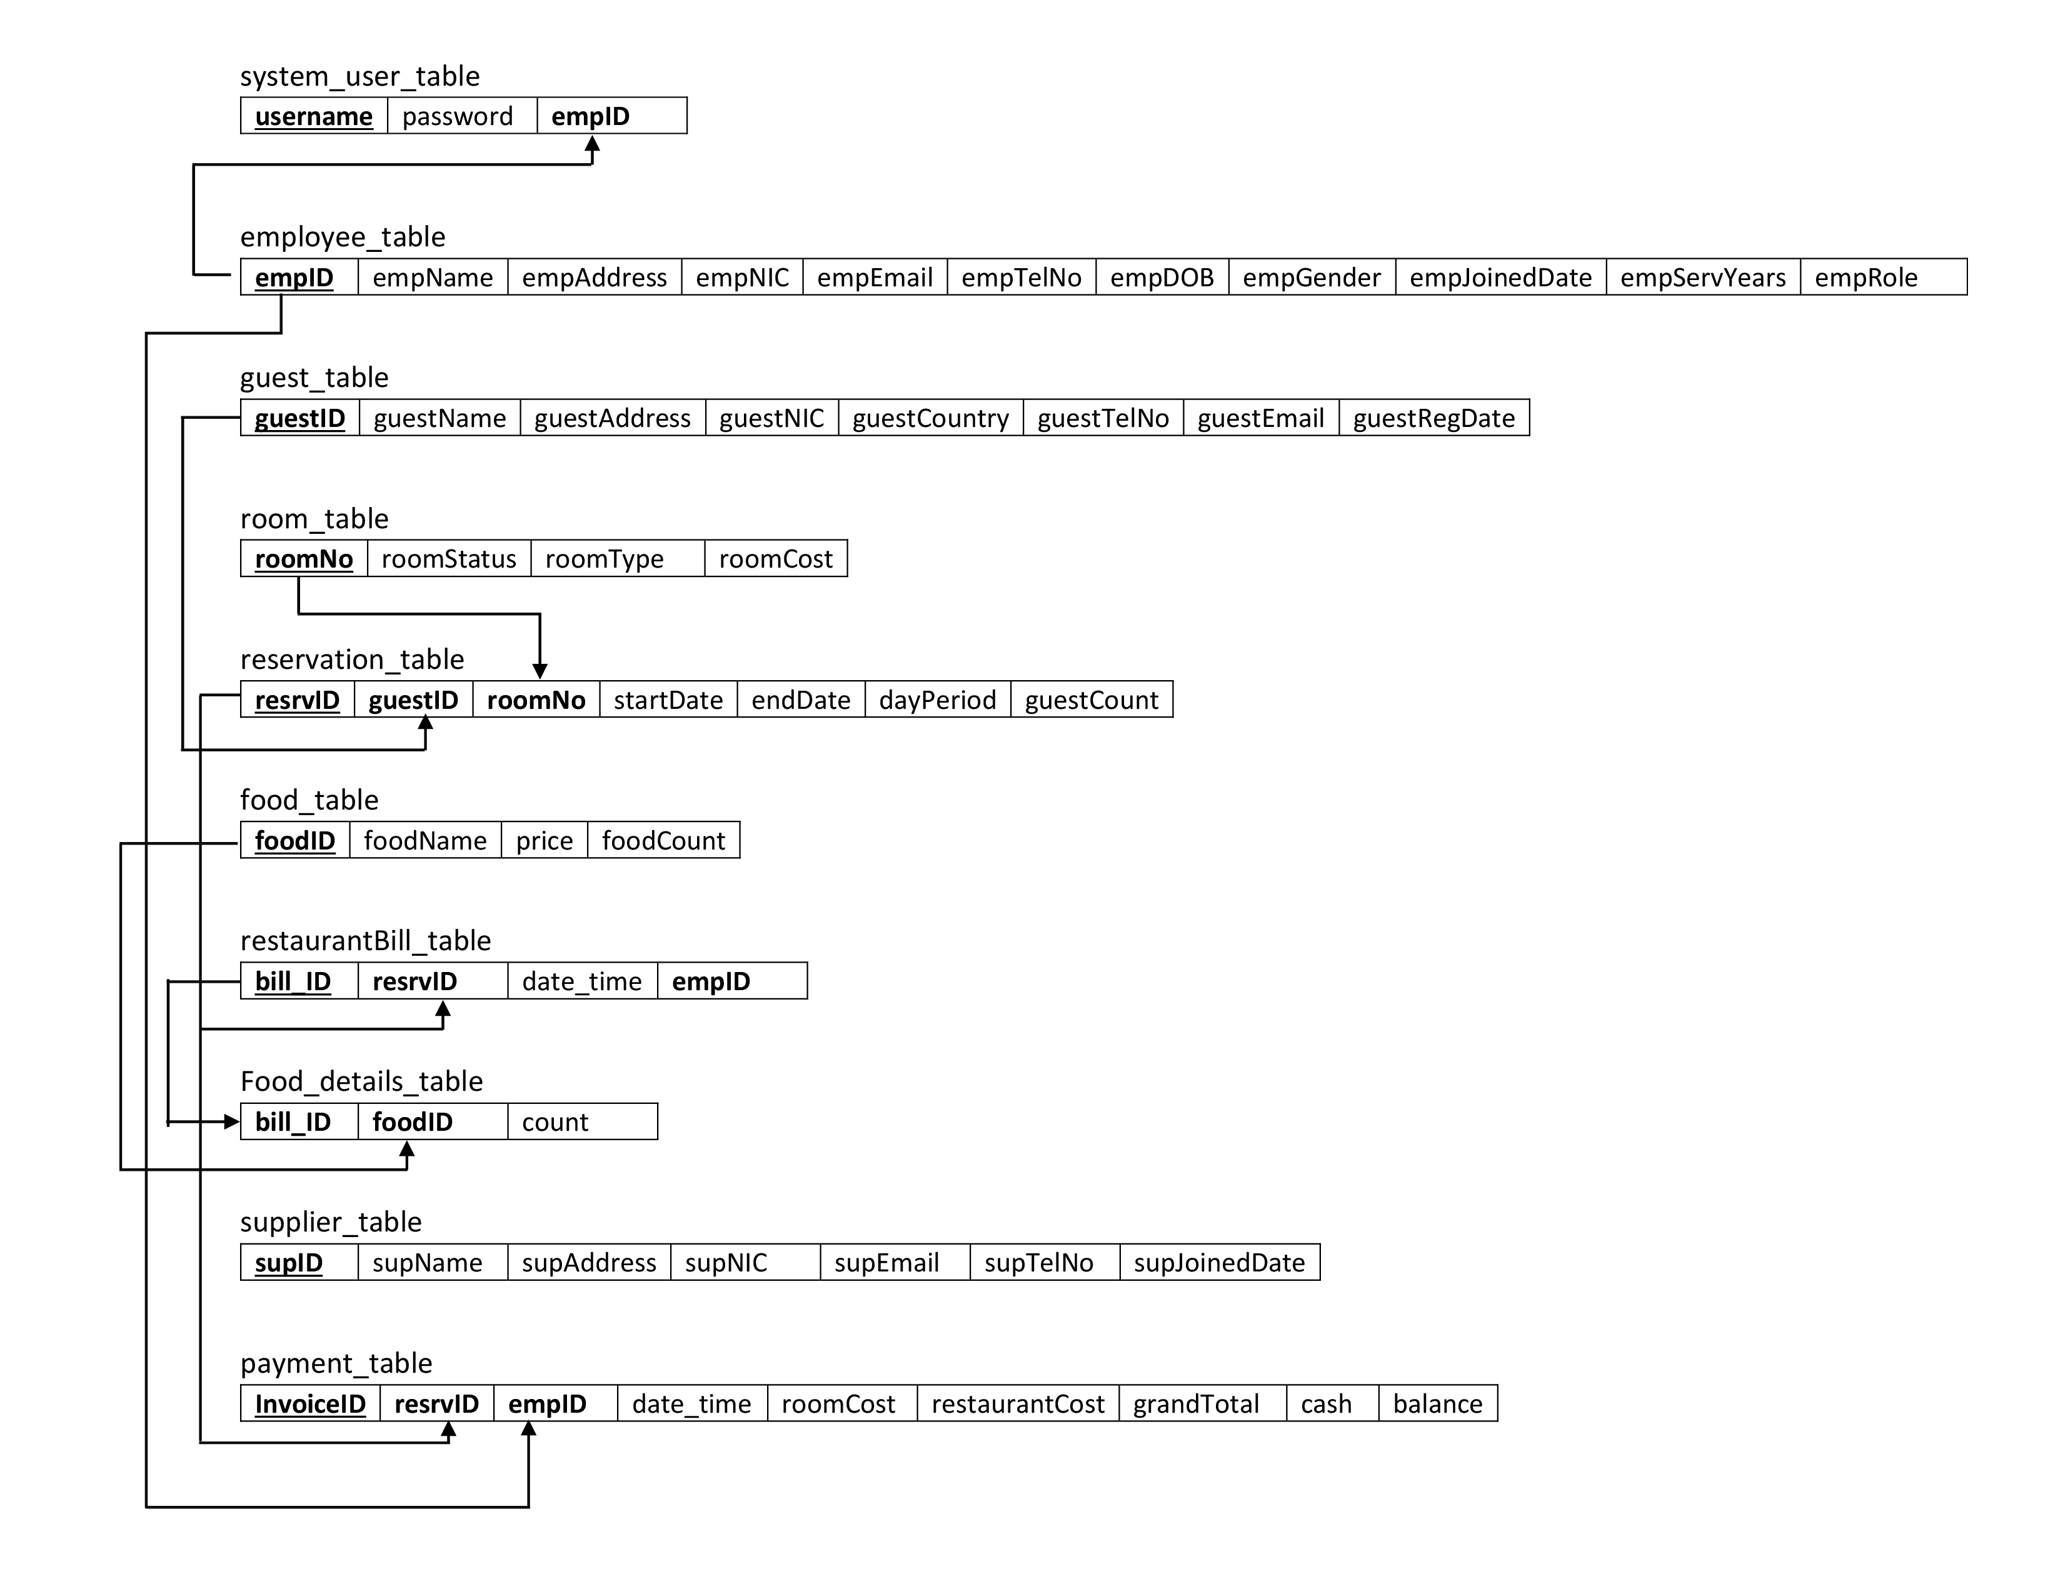

Slide 8

Thank you…

